Slide 1

PREDICTION OF SUITABLE CROP USING MACHINE LEARNING
In-House Project
Project Guide : Dr. Himangi Pande
School of Computer Engineering and Technology [ SCET]
Group A18

Slide 2
Group Members:
1. Name: Shranay Shahane
PRN: 1032190916
Contact No: 9860574452
Email Id: shranayshahane@gmail.com
2. Name: Sakshi Dongre
PRN: 1032191997
Contact No: 8825107744
Email Id: sakshidongre125@gmail.com
3. Name: Nihaal Shetty
PRN: 1032190927
Contact No: 8669203084
Email Id: nihalshetty29@gmail.com
4. Name: Shivansh Kushwaha
PRN: 103280745
Contact No: 8461955459
Email Id: 103280745@mitwpu.edu.in

Slide 3
Table of Content
Literature Survey
Introducion
Problem Statement
Project Requirements
Objectives
System Architecture
Methodology
Future Scope
Conclusion

Slide 4
Introduction
•Since its start, agriculture has been the main activity in every society and civilization that has existed throughout human history. It is not only a huge part of the expanding economy, but it is also crucial to our survival.
•Due to growing population, the demand for agricultural products is ever increasing and to meet these needs it is essential to have high yields every year. However, environmental factors like rain and soil impact the crop and can have negative as well as positive effects on the yield.
•Farmers have to make a choice of which crop to grow based on the natural factors of the farm like soil and climate around it. If these farmers are assisted and provided with accurate information the yield can be improved.
•Machine Learning is a very good approach to assist in the decision making process helping farmers to make the best possible decisions and right choices.

Slide 5
Literature Survey
Sr. No. | Authors | Title | Link | Takeaways | Research Gaps
01 | Janmejay Pant, R.P. Pant, Manoj Kumar Singh, Devesh Pratap Singh, Himanshu Pant | Analysis of agricultural crop yield prediction using statistical techniques of machine learning (ScienceDirect, 2021) | https://www.sciencedirect.com/science/article/pii/S0168169920302301 | The dataset includes features like rainfall, pesticide used, yield production of specific year, average temperature, etc. From the comparative analysis performed, it is pretty clear that the Decision Tree Regressor was the best approach for the given dataset with an accuracy of 96%. | The research work does not consider major factors like soil, humidity, ph values, etc. The research work also does not factor the land under cultivation in attempt to generalise the result to the whole country which might give wrong results since the climate change could be vast over the country affecting crop production.
02 | Benny Antony | Prediction of the production of crops with respect to rainfall (ScienceDirect, 2021) | https://www.sciencedirect.com/science/article/abs/pii/S001393512100918X | According to the comparative analysis done in the research paper, decision tree, random forest and XGboost appear to be the best fitting machine learning algorithms for all the datasets each having slight differences in their MAE. This research work only focuses on measuring the impact of rainfall on various crops in various states. Support Vector Machine seems to have the highest MAE in all the individual cases. | The research work only considers the impact of rain on the crops and not the other factors like the soil, temperature, humidity, etc. Production/Area is measured for individual crops and states which does not render the relationship between the climate or state and the crops. Hence, it cannot be determined which crops are more or less suitable for which environment.

Slide 6
Literature Survey
Sr. No. | Authors | Title | Link | Takeaways | Research Gaps
03 | C.G. Anupama, C. Lakshmi | A comprehensive review on the crop prediction algorithms (Science Direct, 2021) | https://www.sciencedirect.com/science/article/pii/S2214785321006404 | Clustering and Classification approaches are widely used for crop yield prediction models. Naive Bayes, Random Forest and Decision Trees are the most used machine learning approaches used in these projects. Most considered features in the datasets are rainfall, location, soil type, crops and area of land. | The comparative analysis between different approaches and algorithms has not been performed. Most papers do no discuss or consider some important factors like Humidity, NPK values in soil, ph value of soil, etc. which can have major impact on the prediction outcome.
04 | Anakha Venugopal, Aparna S, Jinsu Mani, Rima Mathew, Vinu Williams | Crop Yield Prediction using Machine Learning Algorithm (IJERT, 2021) | https://www.ijert.org/crop-yield-prediction-using-machine-learning-algorithms | Based on the results, it can be determined that random forest algorithm was the best fit for the dataset with highest accuracy of 92.8%, followed by Naive Bayes with an accuracy of 91.5% and at last logistic regression with an accuracy of 87.8% Factors like wind speed, rainfall, humidity, temperature were considered for the training of the Machine Learning Model. | The soil data of a farmland has not been yet introduced as one of the features which will have significant impact on the final results of the prediction engine. A few other algorithms like Decision Trees and Support Vector Machine which could potentially have provided better results were not tested. The data was location dependent limiting the model predictions to the state of Kerala.

Slide 7
Literature Survey
Sr. No. | Authors | Title | Link | Takeaways | Research Gaps
05 | Kim Nari, Lee Yang-Won | Machine Learning Approaches to Corn Yield Estimation Using Satellite Images and Climate Data (Journal Paper) | https://koreascience.kr/article/JAKO201625752504104.page | Remote sensing data has been widely used in the estimation of crop yields by employing statistical methods such as regression model. Satellite images from MODIS is used and the climate reanalysis data is created by PRISM for the machine learning analyses. | The model is very complex with many parameters and shows a poor predictive performance by overreacting to minor fluctuations in dataset; which resulted overfitting problem.
06 | S Bharath, Yeshwanth S, Yashas B L, Vidyaranya R Javalagi | Comparative Analysis of Machine Learning Algorithms in The Study of Crop and Crop yield Prediction (Journal Paper) | https://www.ijert.org/research/comparative-analysis-of-machine-learning-algorithms-in-the-study-of-crop-and-crop-yield-prediction-IJERTCONV8IS14008.pdf | Prediction of crop and crop yield is done on the basis of input values pertaining to rainfall, soil pH, temperature . This also demonstrates comparative study of algorithms with the amount of accuracy and r2 score they obtained and suggesting best algorithm which could be implemented for predicting the crop and yield respectively . | Major algorithm like ANN is not tested.

Slide 8
Literature Survey
Sr. No. | Authors | Title | Link | Takeaways | Research Gaps
07 | Fatin Farhan Haque, Ahmed Abdelgawad, Venkata Prasanth Yanambaka, Kumar Yelamarthi | Crop Yield Analysis Using Machine Learning Algorithms (Conference Paper) | https://ieeexplore.ieee.org/abstract/document/9221459 | In this paper, two different ML algorithms are used and that is Support Vector Regression(SVR) and Linear Regression. The error rate was measured with the help of Mean Square Error (MSE) and Coefficient of Determination (R 2). | The paper does not include comparative analysis of the algorithm with other major prediction algorithms.
08 | Kodimalar Palanivel, Chellammal Surianarayanan | An Approach for Prediction of Crop Yield Using Machine Learning and Big Data Techniques (Journal Paper) | https://papers.ssrn.com/sol3/papers.cfm?abstract_id=3555087 | An investigation has been performed on how various machine learning algorithms are useful in prediction of crop yield. The expert system such as fuzzy logic is based on logical rules to predict the yield. | Model was very complex that’s why diverse machine learning techniques were adopted.

Slide 9
Literature Survey
Sr. No. | Authors | Title | Link | Takeaway | Research Gaps
09 | D Ramesh, Vishnu Vardhan | Analysis Of Crop Yield Prediction Using Data Mining Techniques (Research Paper) | https://ijret.org/volumes/2015v04/i01/IJRET20150401071.pdf | Brief analysis of crop yield prediction using Multiple Linear Regression (MLR) technique and Density based clustering technique for the selected region i.e. East Godavari district of Andhra Pradesh in India | In this paper dataset was made from a particular selected region that is East Godavari District.
10 | Vaishali Pandith Haneet Kour, Surjeet Singh , Jatinder Manhas, and Vinod Sharma | Performance Evaluation of Machine Learning Techniques for Mustard Crop Yield Prediction from Soil Analysis (Research Paper) (2020) | https://bhu.ac.in/research_pub/jsr/Volumes/JSR_64_02_2020/54.pdf | KNN, Naive Bayes, , Multinomial Logistic Regression, Artificial Neural Network (ANN) and Random Forest were applied on the collected data. Parameters like pH value, Electrical conductivity and other chemical factors were used. | Parameters like Rainfall, Temperature, Pesticides were not used.

Slide 10
Literature Survey
Sr. No. | Authors | Title | Link | Takeaways | Research Gaps
11 | Mummaleti Keerthana; K J M Meghana; Singamsetty Pravallika; Modepalli Kavitha | An Ensemble Algorithm for Crop Yield Prediction (Research Paper) (2021) | https://ieeexplore.ieee.org/document/9388479 | Implementation of predicting the crop type based on parameters using ensemble techniques. Combination of AdaBoost Regression with Decision Tree gave highest accuracy of 95.7%. | Ensemble technique could be used to combine more than two algorithms
12 | Saeed Khaki* and Lizhi Wang | Crop yield Prediction using Deep Neural Networks (Research Paper) (22 May 2019) | https://www.frontiersin.org/articles/10.3389/fpls.2019.00621/full | Deep Neural Network is used For prediction. Performance of the model was found to be relatively sensitive to the quality of weather | Results was dependent on weather prediction

Slide 11
Problem statement
To create and design a web-based user application that will predict the most suitable crop for the given environmental condition of the farmland using machine learning.

Slide 12
Project Requirements
Hardware Requirements:
Machine that supports python development environment.
Software Requirements:
Crop Data Set
https://www.kaggle.com/datasets/atharvaingle/crop-recommendation-dataset

Slide 13
Objectives
To identify the features affecting the crop yields from the selected database.
To test different machine learning algorithms on the selected database and perform a comparative analysis.
To create a prediction model that will predict the most suitable crop for the user’s given environmental conditions and soil type.
To create a user-friendly web based application that will act as an interface between the user and the prediction engine.

Slide 14
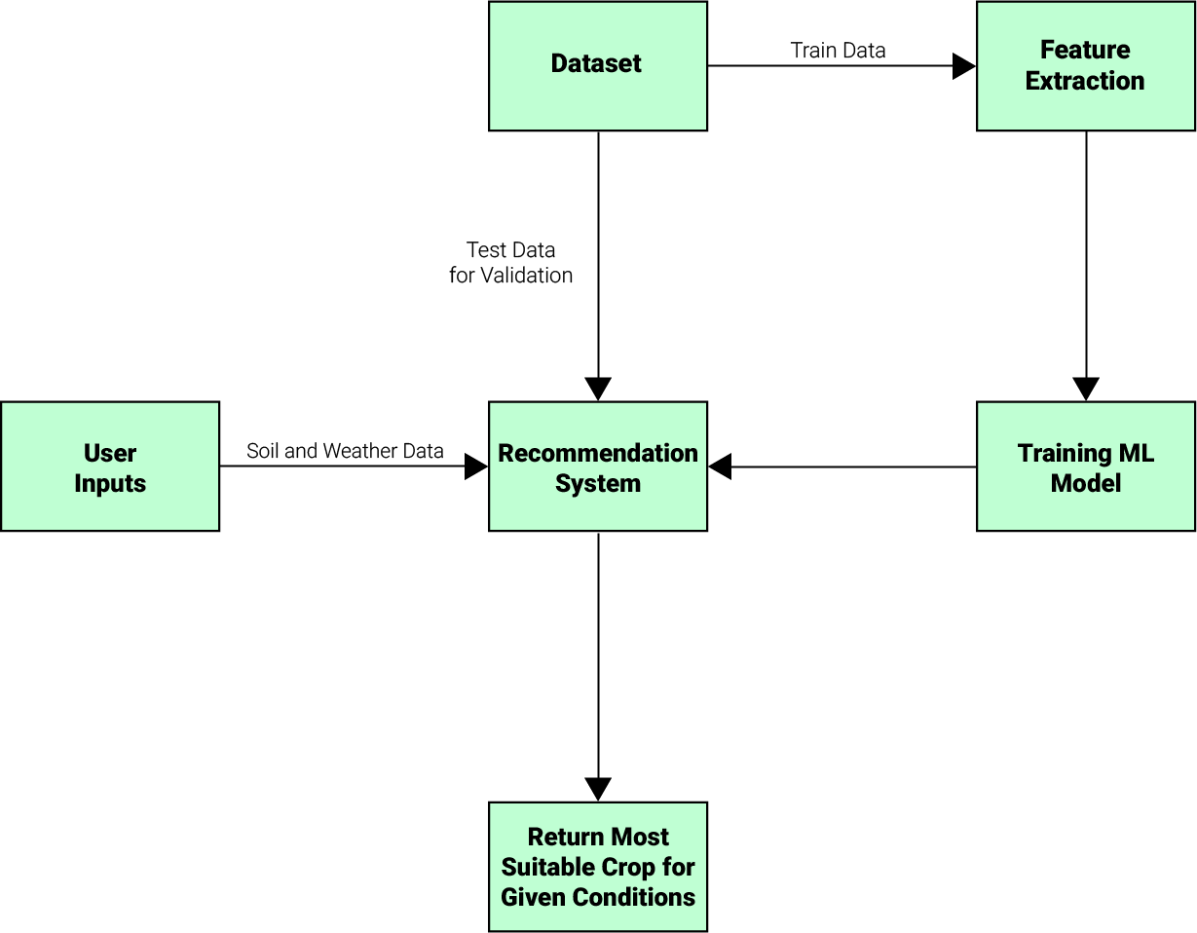
System Architecture
Fig 1. System Architecture

Slide 15
Methodology
Pre-process and clean the dataset.
Perform Exploratory Data Analysis on the Dataset.
Test various machine learning algorithms.
Perform an extensive comparative analysis.
Choose an algorithm for the final model.
Create a simple web based and integrate it with the machine learning model.

Slide 16
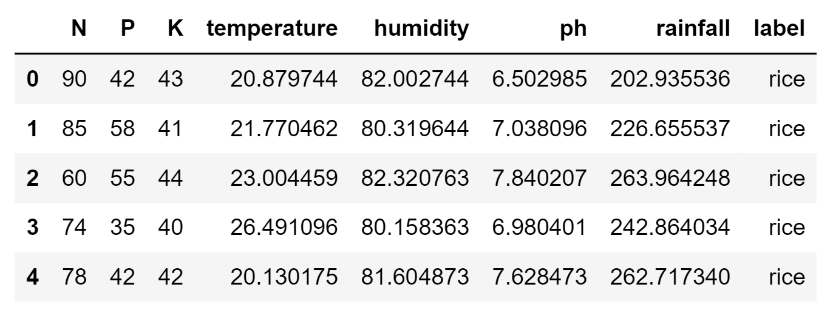
Fig 2. Dataset Preview

Slide 17
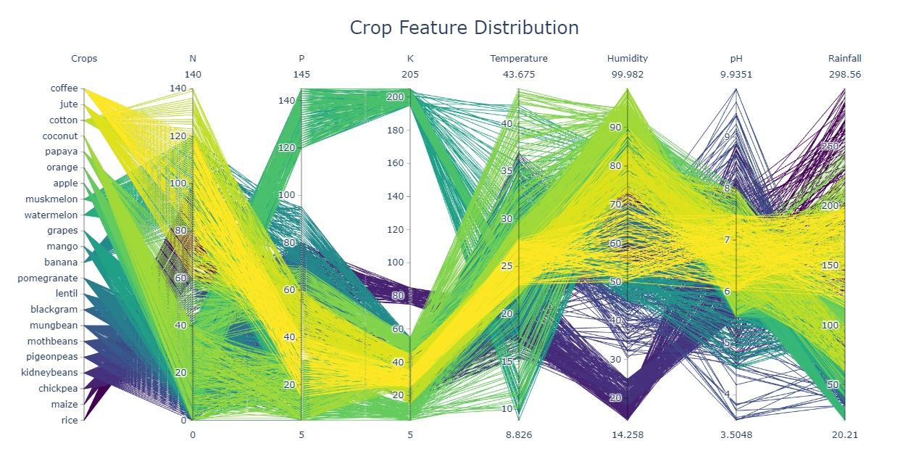
Fig 3. Crop Feature Distribution

Slide 18
Algorithms tested
Decision Tree
Naive Bayes
Support Vector Machine
Logistic Regression
Random Forest
XGBoost
KNN (K-Nearest Neighbour)
Ensemble Model

Slide 19
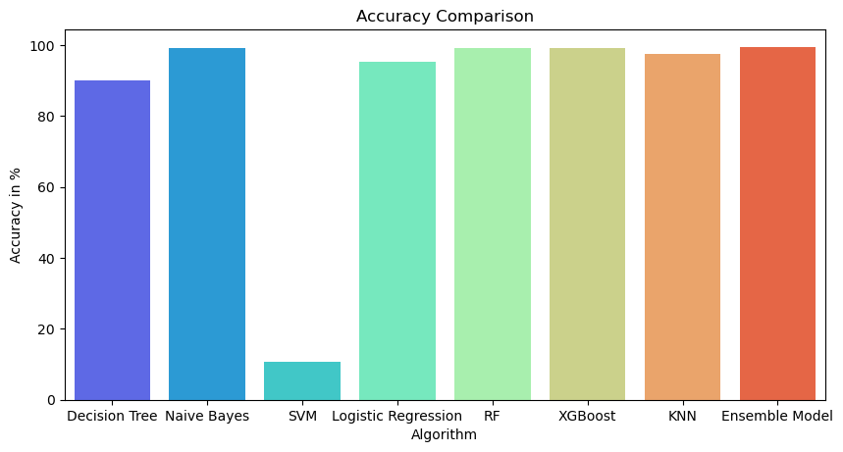
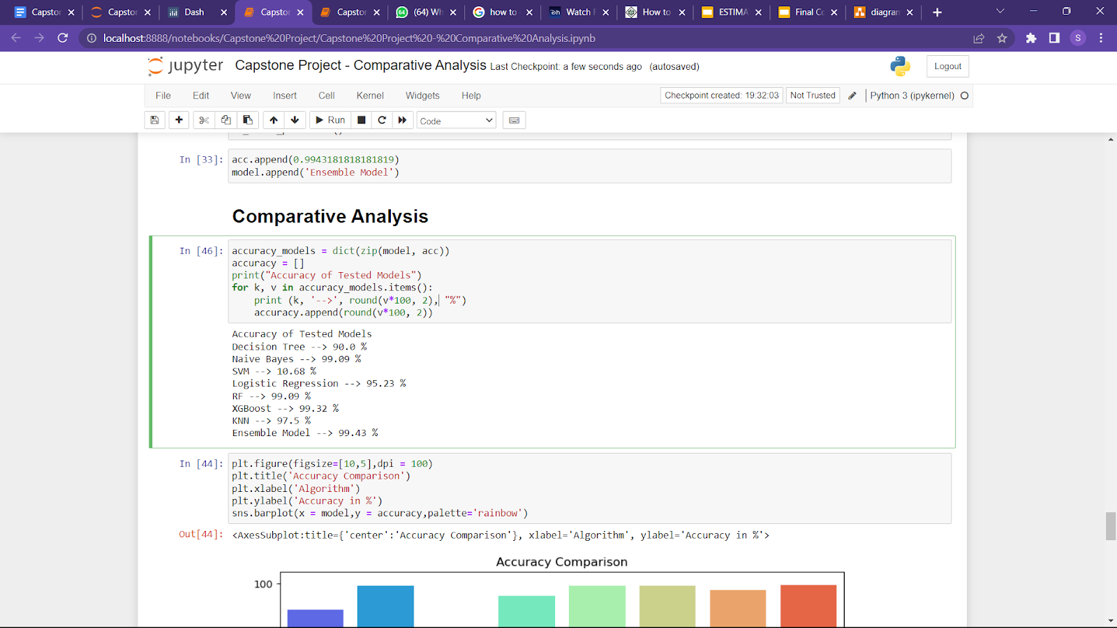
Fig 4. Accuracy comparison between different machine learning algorithms

Slide 20
Module wise distribution
Machine Learning Module: This module consists of the core decision system and trained machine learning model which will make the predictions. This module will include tasks like Data Preprocessing, Implementation of machine learning algorithms, testing trained models against test data sets, etc.
Front End Module: This module will include a web based application that will act as an interface between the machine learning module and the user. This module will include tasks like creating a web page, connecting the web page to the machine learning module, etc.

Slide 21
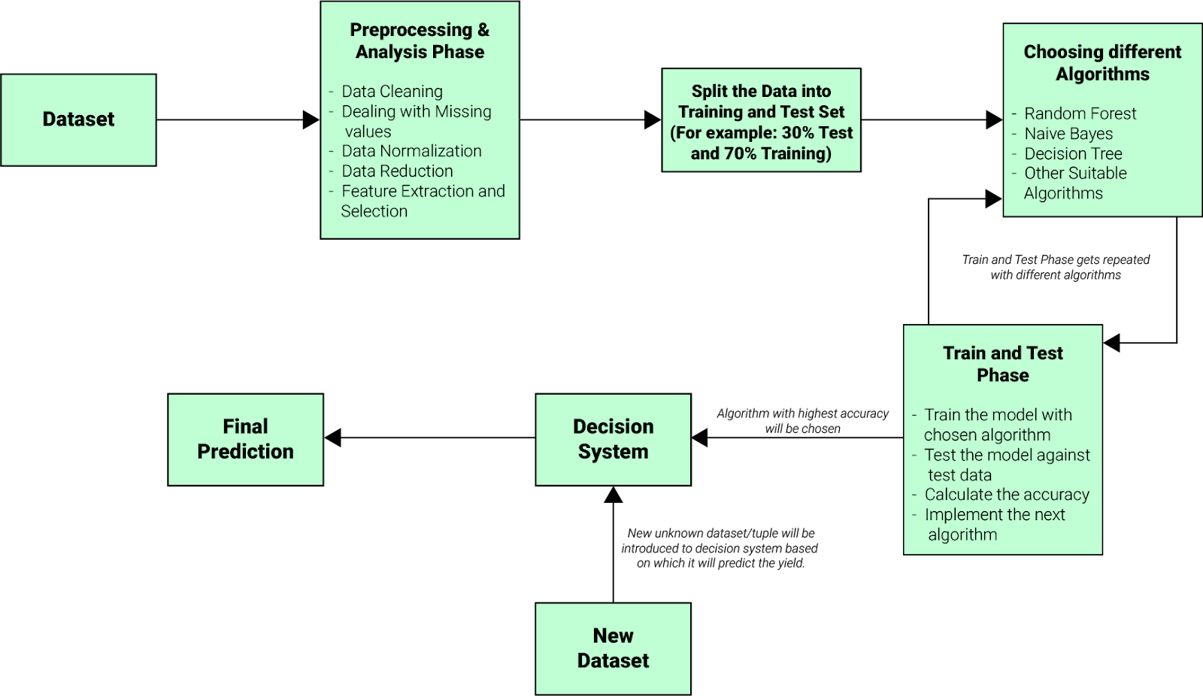
Machine Learning Module Architecture
Fig 5. Machine Learning Module Architecture

Slide 22
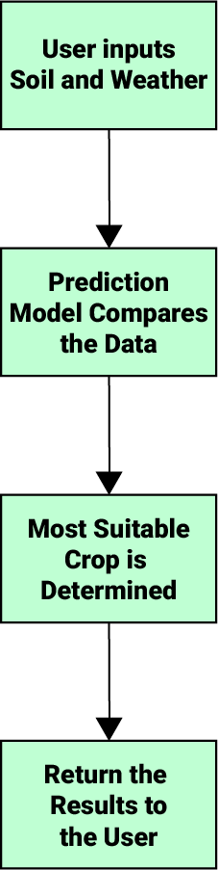
Front End Module Architecture
Fig 6. Front End Module Architecture

Slide 23
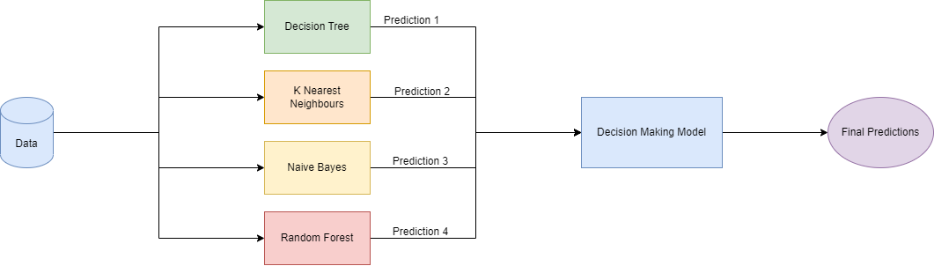
Prediction Algorithm
Final prediction model is an ensemble model that has been created by combining a Decision Tree Model, KNN model. Naive Bayes model and Random Forest model.
Ensemble modelling is the act of executing two or more related but separate analytical models and then combining the results into a single model.
Fig 7. Prediction Algorithm

Slide 24
Front-End Module
For front-end Dash is used to create the web application.
Dash is an open-source Python framework used for building analytical web applications
Dash is a powerful library that simplifies the development of data-driven applications.
Dash apps consist of a Flask server that communicates with front-end React components using JSON packets over HTTP requests.
Dash applications are written purely in python, so NO HTML or JavaScript is necessary.

Slide 25
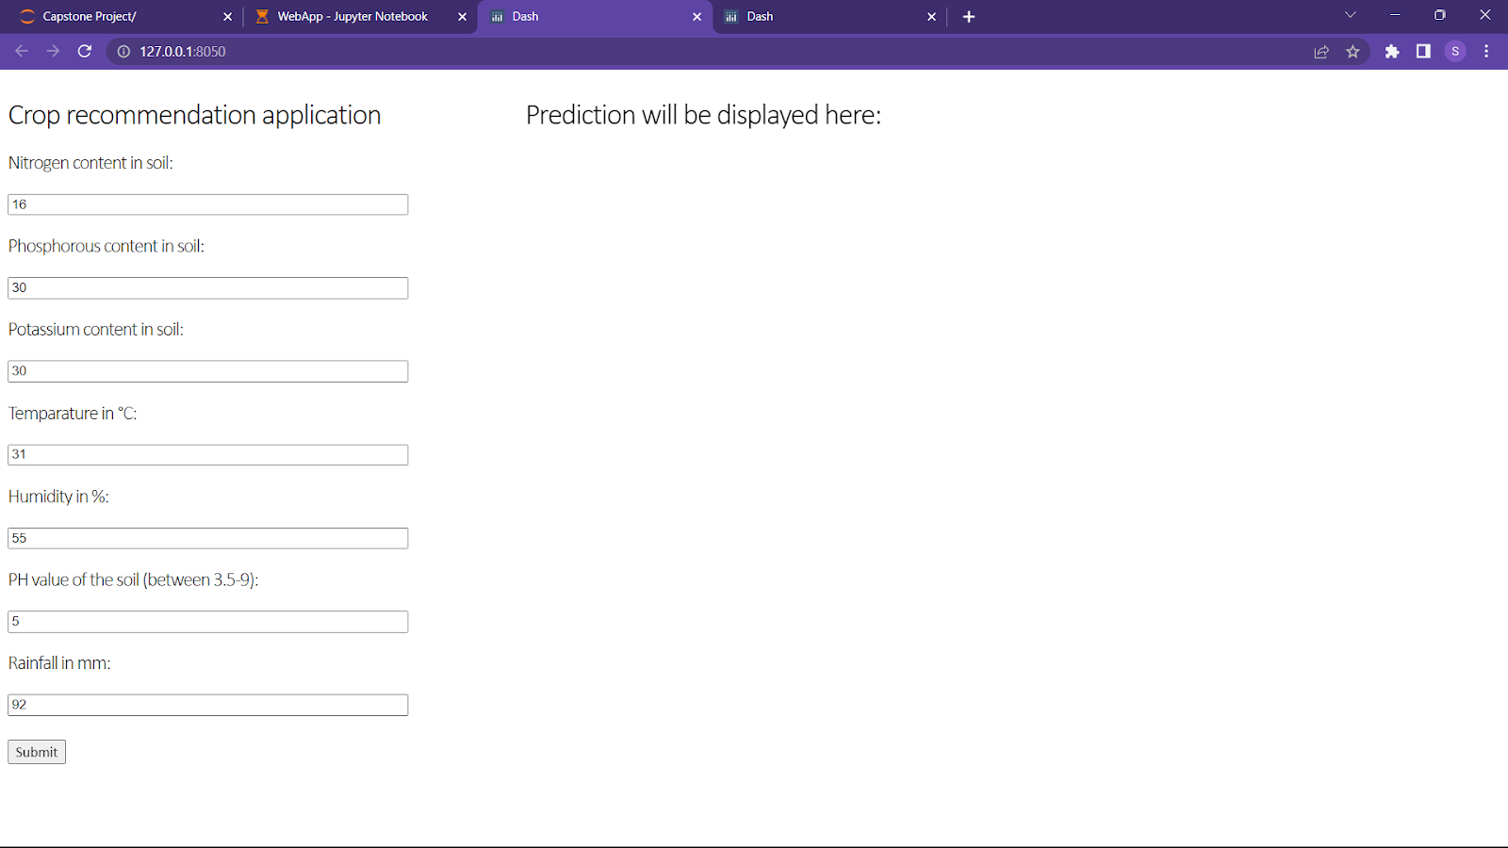
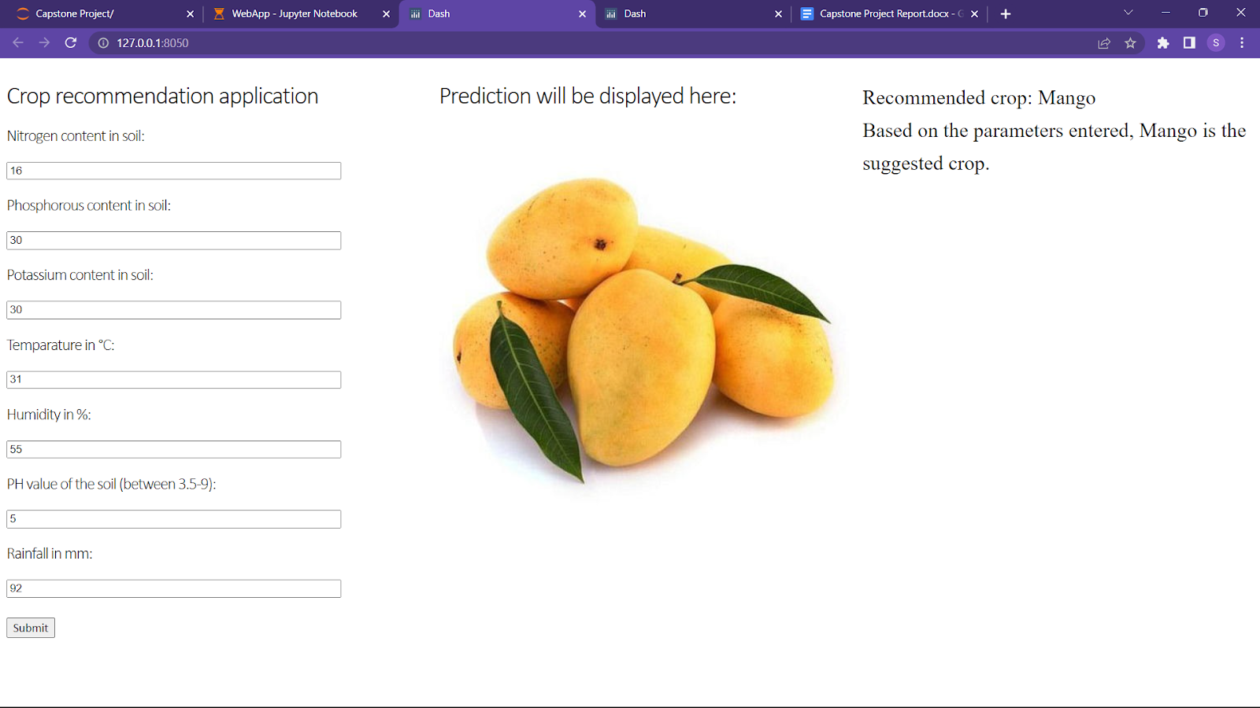
Front-End Screenshot

Slide 26
Future Scope
More factors like wind, altitude level, etc. can be added that can alter the yield of a crop.
Further progress can be made to make the prediction real time allowing the model to consider the factors that were not present initially, for example, fertilizer, pesticide, etc.
Data can be collected for same crops with different biological species to figure out which species flourishes in which environment making the job of the farmer much easier.

Slide 27
Conclusion
With the help of different machine learning algorithms and techniques a user friendly application will be created that assists the farmers make the best choices and decisions while choosing the crop.
This will not only increase the yield production but also is likely to help farmers avoid any potential loss due to choosing a crop that might not survive the extremities of the climate of the farm.
Choosing right crops also prevents the soil from further quality degradation and in general again helps to improve the yield.

Slide 28
Individual Contributions
Shranay Shahane (1032190916)
Objective:
Pre-process the datasets
Perform exploratory data analysis
Test various machine learning algorithms
Perform a comparative analysis
Create the machine learning model.
Contribution:
Successfully implemented machine learning module module.
Performed comparative analysis on various algorithms
Implemented the final ensemble model

Slide 29
Individual Contributions
Nihaal Shetty (1032190927)
Objective:
To Create a simple web GUI
To integrate Machine learning model with GUI
Create GUI user friendly.
Contribution:
Successfully implemented some parts module 2
Hence created a successful User Friendly Interface

Slide 30
Individual Contributions
Sakshi Dongre (1032191997)
Objective:
To create a web-based visualization dashboard using machine learning.
Perform data visualisation techniques on the dataset.
Contribution:
Successfully implemented some parts module 2.
Visualised the dataset.
Created a web-app with crop feature distribution.

Slide 31
References
https://www.analyticsvidhya.com/blog/2018/06/comprehensive-guide-for-ensemble-models/
https://www.analyticsvidhya.com/blog/2017/09/common-machine-learning-algorithms/
https://medium.com/plotly/introducing-dash-5ecf7191b503
https://www.academia.edu/49636443/Crop_Recommendation_System_using_Machine_Learning
https://medium.com/hub-konam-foundation/predicting-crop-yield-and-profit-with-machine-learning-1d9c3216faf7
https://www.researchgate.net/publication/346627389_Crop_Recommendation_System
https://www.geeksforgeeks.org/visualization-and-prediction-of-crop-production-data-using-python/

Slide 32
Thankyou

